Slide 1
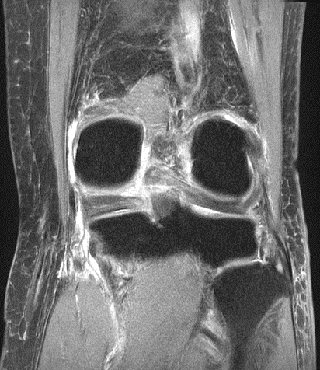
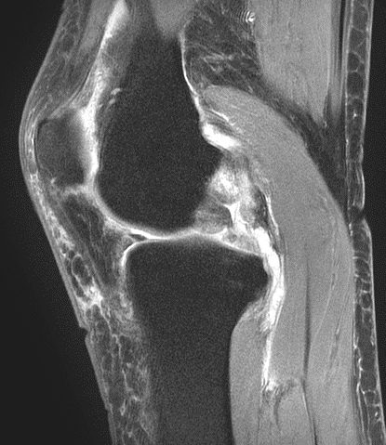
a
b
Figure 1

Slide 2
Tibial longitudinal axis
●
MTS
Line 1
Line 2
Figure 2

Slide 3
*
*
MTSA (˚)
Unilateral
MMPRT
Bilateral
MMPRT
(Contralateral)
Bilateral
MMPRT
(Primary)
Figure 3

Slide 4
1.0
0.8
0.6
Sensitivity
0.4
0.2
AUC: 0.83
0.0
1.0
0.8
0.6
0.4
0.2
0.0
Specificity
Figure 4

