Slide 1
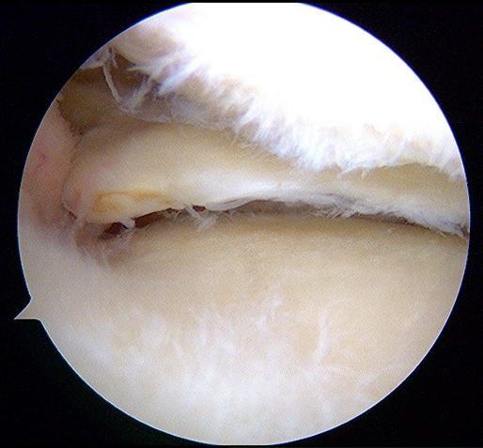
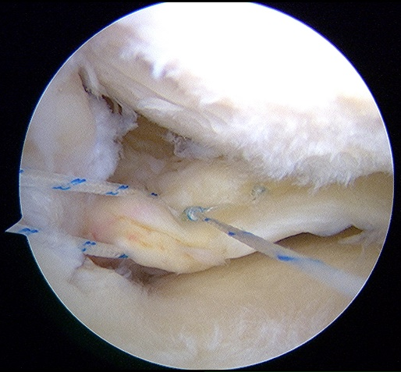
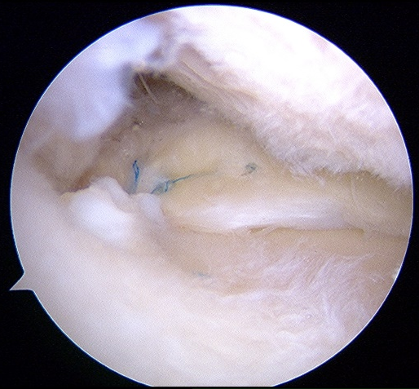
A
B
C
MFC
PR
FasT-Fix
MTP
#2 Ultrabraid
Fig. 1
Notes:
いとうやちよ

Slide 2
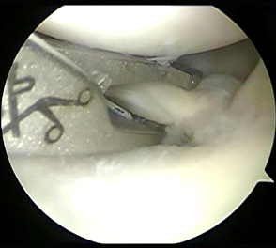
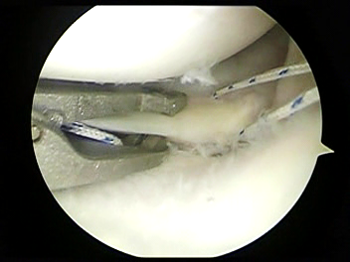
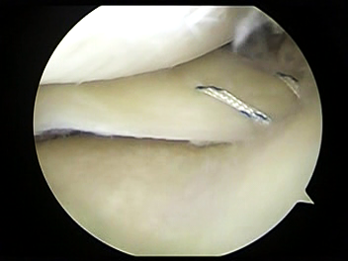
A
MFC
B
C
PR
#2 Ultrabraid
MTP
#2 Ultrabraid
Fig. 2

Slide 3
**
**
**
**
**
**
**
**
Clinical scores
Pain
Symptoms
ADL
Sport/Rec
QOL
Lysholm
IKDC
VAS
KOOS
Fig. 3

Slide 4
**
**
**
**
**
**
**
**
Clinical scores
Pain
Symptoms
ADL
Sport/Rec
QOL
Lysholm
IKDC
VAS
KOOS
Fig. 4

Slide 5
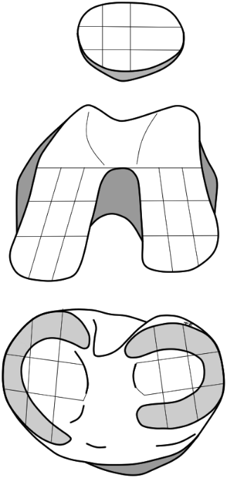
a
b
P
P
(1.9)
(2.0)
T
T
(2.1)
Mean
ICRS grade
(2.5)
Mean
ICRS grade
MFC
LFC
2.5
MFC
LFC
2.5
(2.1)
(1.5)
(2.4)
(1.5)
2.0
2.0
MTP
LTP
1.5
MTP
LTP
1.5
(1.9)
(2.1)
(2.1)
(1.8)
1.0
1.0
Fig. 5

Slide 6
a
b
P
P
(1.8)
(1.9)
T
T
(2.1)
Mean
ICRS grade
(2.0)
Mean
ICRS grade
MFC
LFC
2.5
MFC
LFC
2.5
(2.3)
(1.7)
(2.0)
(1.7)
2.0
2.0
MTP
LTP
1.5
MTP
LTP
1.5
(1.8)
(2.0)
(1.8)
(1.9)
1.0
1.0
Fig. 6

