Slide 1
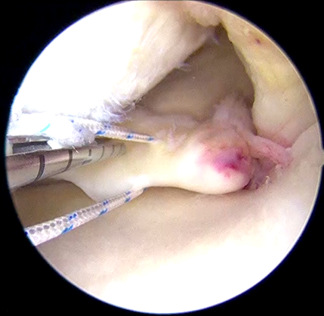
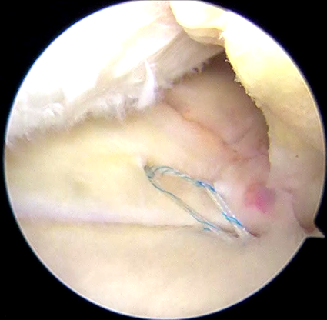
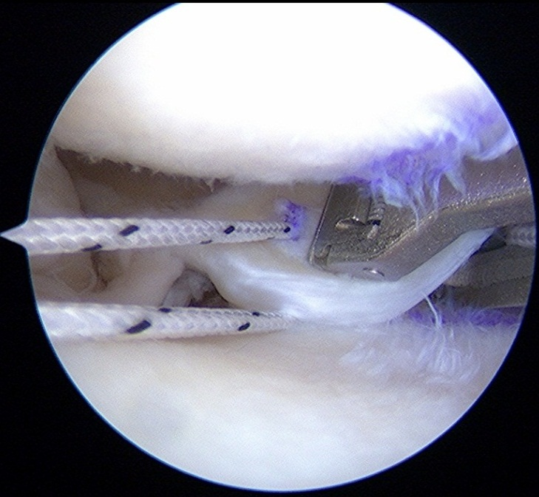
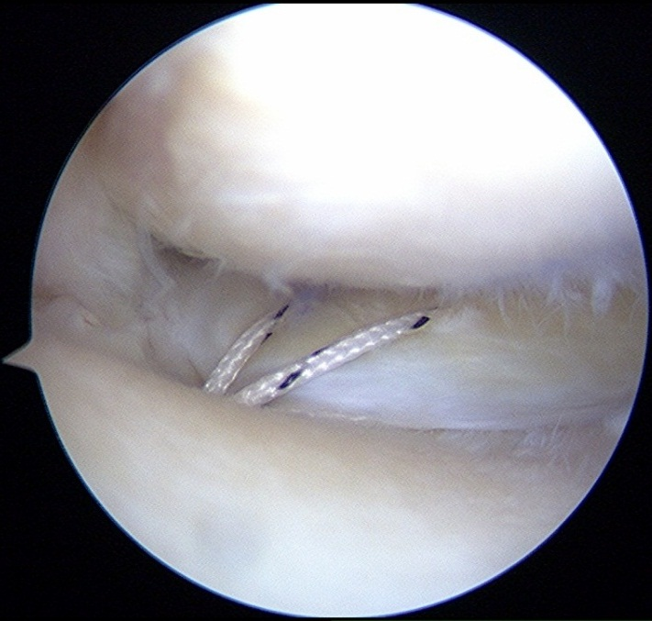
A
MFC
B
MFC
FasT-Fix
PCL
PCL
FasT-Fix-dependent modified Mason-Allen suture
FasT-Fix
PR
PR
#2 Ultrabraid
#2 Ultrabraid
MTP
C
MFC
D
Knee Scorpion
MFC
Two simple stitches
PR
PCL
PR
MTP
#2 TigerStick
#2 TigerStick
Figure 1

Slide 2
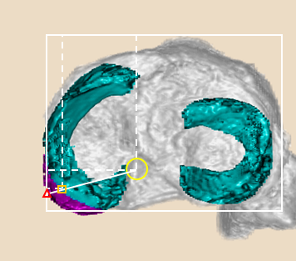
A
Point E
Point A
Point I
B
0
-5
6
38
Posterior (%)
77
85
88
100
0
100
Lateral (%)
C
0
6
38
Posterior (%)
77
88
91
100
0
Lateral (%)
100
Figure 2

Slide 3
Figure 3

